Slide 1

TEAM ASSIGNMENT 4
Software Measurement and Analysis
Team : K15T1_Team11
Project Name: Viking Project

Slide 2

TEAM MEMBERS
Le Dinh Thach Huyen (Member)
Dang Huy Son (Member)
Do Minh Tam (Recorder & Sub-leader)
Nguyen Trung Tin (Member)
Le Thi Bich Van (Leader)

Slide 3

CONTENTS
1. Purpose
2. Compare the Schedule between Traditional & Agile software development
3. Measurement Schedule in Traditional software development
4. Measurement Schedule in Agile software development

Slide 4
COMPARE THE SCHEDULE
 | Traditional | Agile
Description | Schedule will be upfront and we will consider actual schedule in schedule Plan. | Schedule following user stories, when customer gives more stories, then schedule will longer. They’re proportional.
Measurement | Big plan upfront & earned value. | Burn Down Chart. Purpose of that is for the team to have visual representation of the amount of work left to complete in the current iteration.

Slide 5
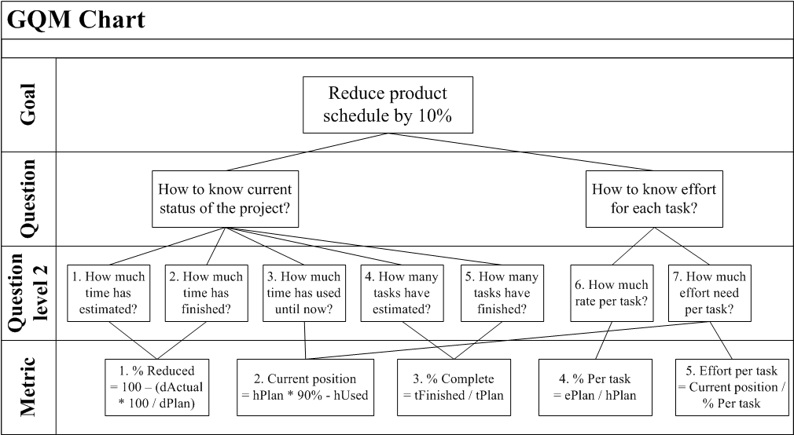
MEASUREMENT SCHEDULE IN TRADITIONAL

Slide 6
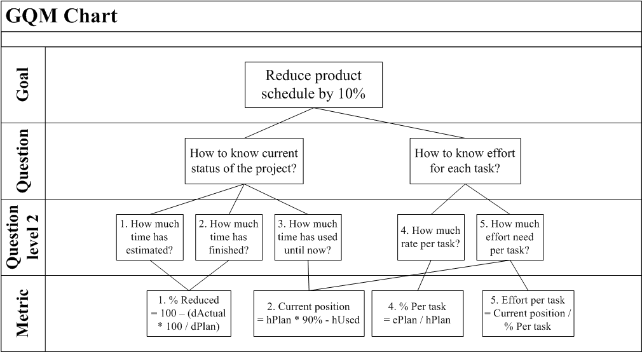
MEASUREMENT SCHEDULE IN AGILE

Slide 7




